Slide 1
Graph of Straight Lines and Quadratic Functions
Mrs. Parami Wattetenne
Lecturer (Probationary)
Department of Multidisciplinary Studies
Faculty of Technology
University of Ruhuna

Slide 2
Topic Covered
Cartesian X-Y plane
Straight Line Equations
Graph of Straight Lines
Qudratic Functions
Graph of Qudratic Functions
Maximum and Minimum Values
System of Linear Equations

Slide 3
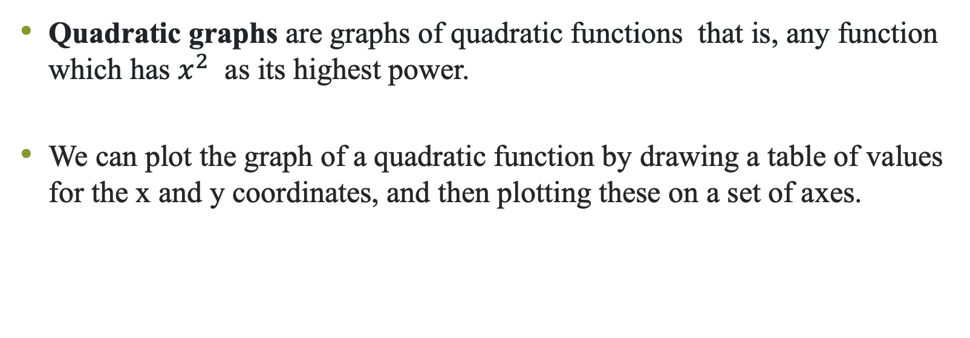
Qudratic Functions
Quadratic graphs are graphs of quadratic functions that is, any function which has $x^{2}$ as its highest power.
We can plot the graph of a quadratic function by drawing a table of values for the x and y coordinates, and then plotting these on a set of axes.

Slide 4
Graph of Qudratic Functions
Once we have drawn the graph of the quadratic function, we can use the graph to find key points.
For a quadratic, these are:
  The roots (where the function crosses the x-axis, and called the x-intercepts)
  The y-intercept
  The vertex (sometimes called the turning point)

Slide 5
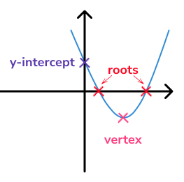
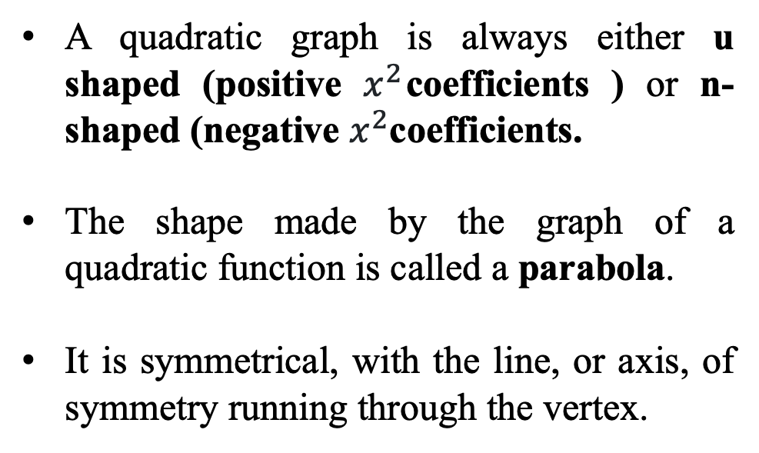
Graph of Qudratic Functions
A quadratic graph is always either u shaped (positive $x^{2}$coefficients ) or n-shaped (negative $x^{2}$coefficients.
The shape made by the graph of a quadratic function is called a parabola.
It is symmetrical, with the line, or axis, of symmetry running through the vertex.

Slide 6
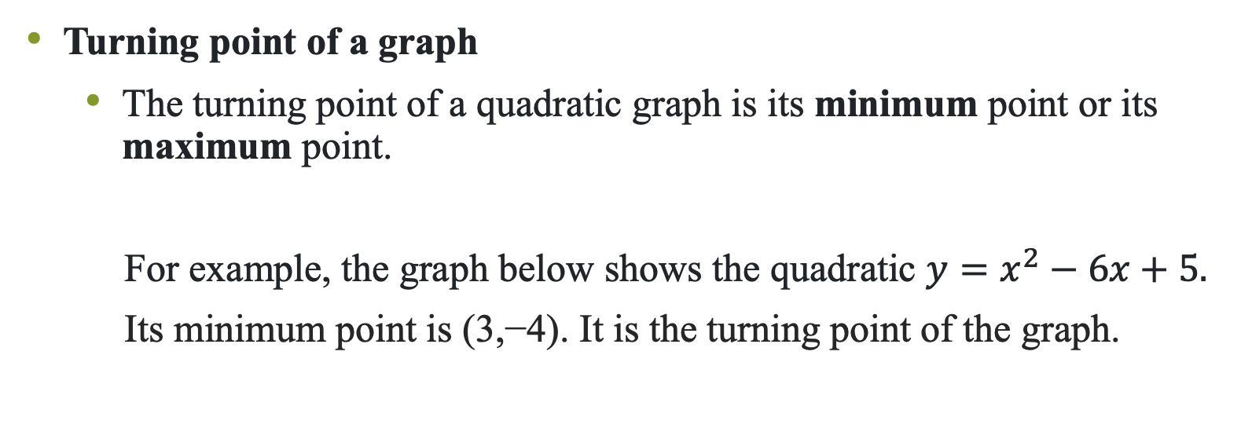
Maximum and Minimum Values
Turning point of a graph
  The turning point of a quadratic graph is its minimum point or its maximum point.
  For example, the graph below shows the quadratic $y=x^{2}−6x+5.$
  $\text{Its} \text{minimum} \text{point} \text{is}\text{ (3,−4). }\text{It} \text{is} \text{the} \text{turning} \text{point} \text{of} \text{the} \text{graph}\text{.}$

Slide 7
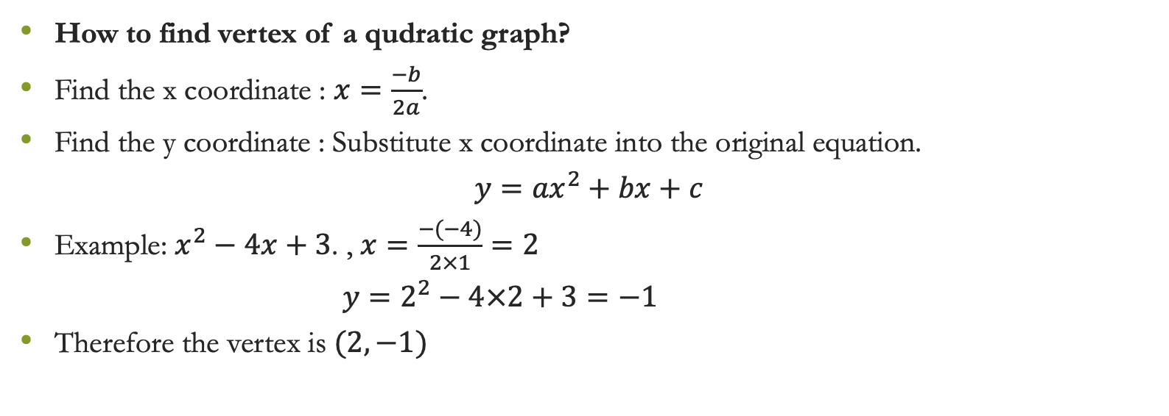
Maximum and Minimum Values
How to find vertex of a qudratic graph?
Find the x coordinate : $x=\frac{−b}{2a}$.
Find the y coordinate : Substitute x coordinate into the original equation.
$y={ax}^{2}+bx+c$
Example: $x^{2}−4x+3$. , $x=\frac{−(−4)}{2×1}=2$
$y=2^{2}−4×2+3=−1$
Therefore the vertex is $(2,−1)$

Slide 8
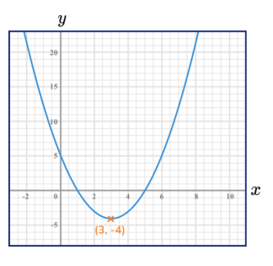
Maximum and Minimum Values
Moving from left to right you can see that the curve is falling, then turns at the minimum point and begins to rise. The gradient is changing from negative to zero to positive.

Slide 9
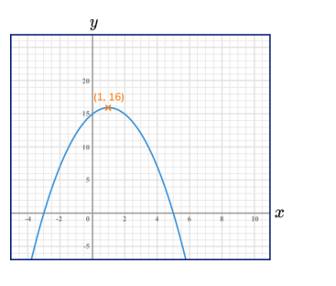
Maximum and Minimum Values
Moving from left to right you can see that the curve is rising, then turns at the maximum point and begins to fall. The gradient is changing from positive to zero to negative

Slide 10
How to use quadratic graphs
There are a variety of ways we can use quadratic graphs:
1. Plotting quadratic graphs
We can plot quadratic graphs using a table of values and substituting values of x into a quadratic function to give the corresponding y values.
Once we have a series of corresponding x and y values we can plot the points on a graph and join them to make a smooth curved u-shaped or n-shaped graph.

Slide 11
How to use quadratic graphs
2. Solving quadratic equations graphically
We can use quadratic graphs to work out estimated solutions or roots for quadratic equations or functions.
We can calculate the roots of a quadratic equation when it equals 0 by noting where the quadratic graph crosses the x axis.
We can calculate the solutions of a quadratic equation by plotting the graphs of the functions on both sides of the equals sign and noting where the graphs intersect.

Slide 12
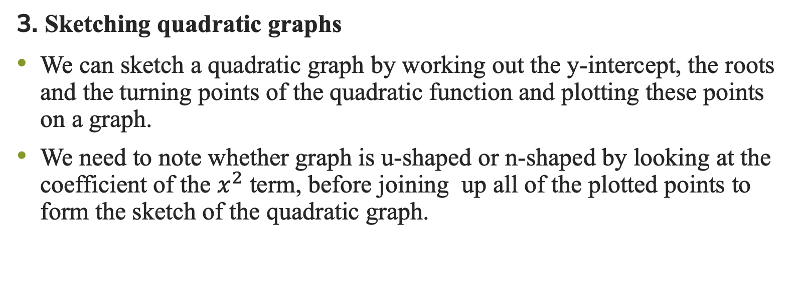
How to use quadratic graphs
3. Sketching quadratic graphs
We can sketch a quadratic graph by working out the y-intercept, the roots and the turning points of the quadratic function and plotting these points on a graph.
We need to note whether graph is u-shaped or n-shaped by looking at the coefficient of the $x^{2}$ term, before joining up all of the plotted points to form the sketch of the quadratic graph.

Slide 13
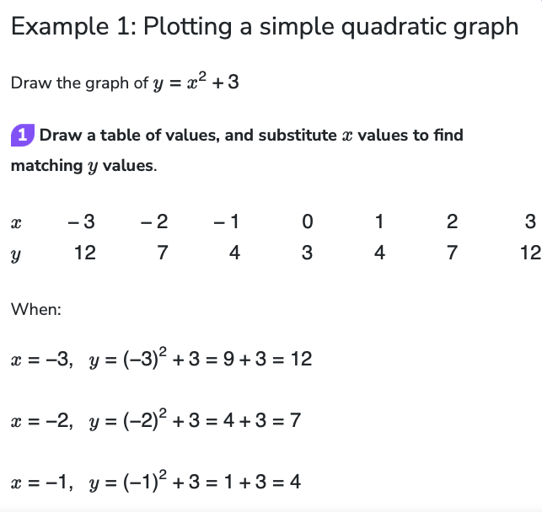
Plotting quadratic graphs

Slide 14
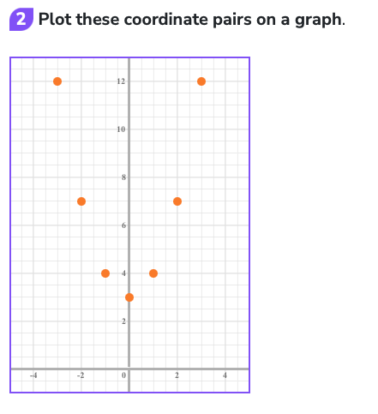
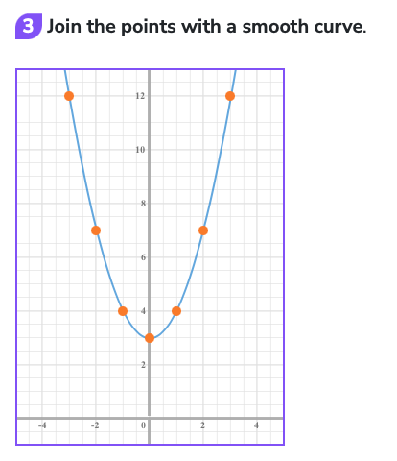
Plotting quadratic graphs

Slide 15
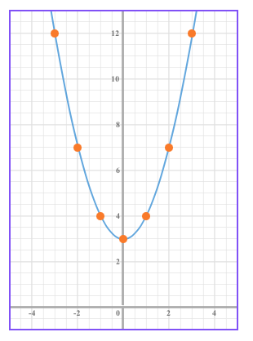
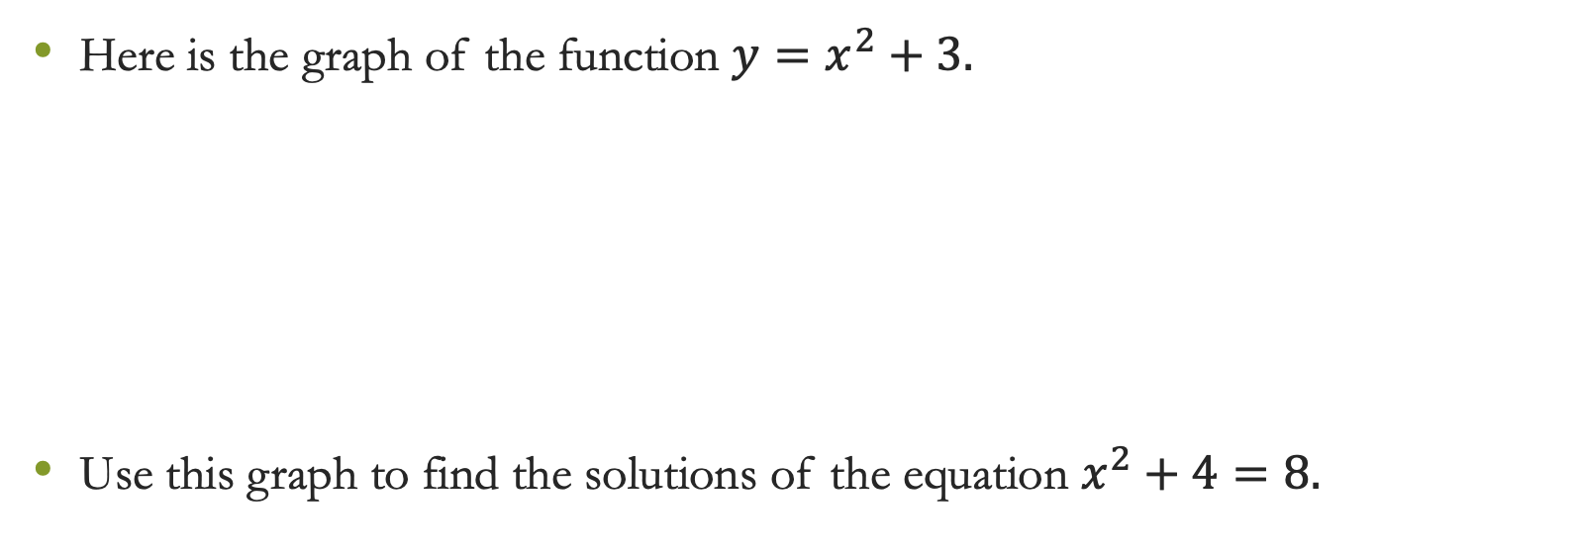
Solving quadratic equations graphically
Here is the graph of the function $y=x^{2}+3.$
Use this graph to find the solutions of the equation $x^{2}+4=8.$

Slide 16
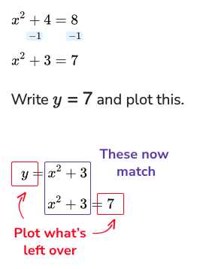
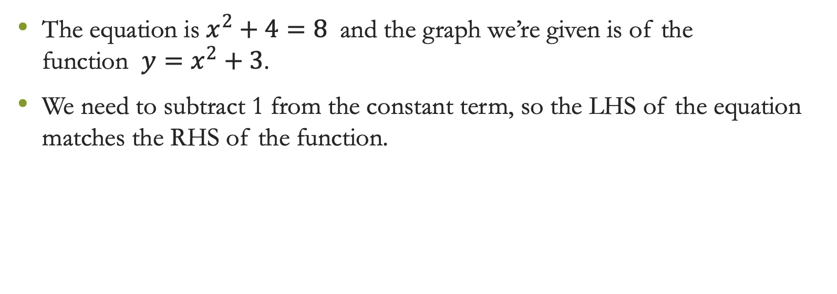
Solving quadratic equations graphically
The equation is $x^{2}+4=8$ and the graph we’re given is of the function $y=x^{2}+3$.
We need to subtract 1 from the constant term, so the LHS of the equation matches the RHS of the function.

Slide 17
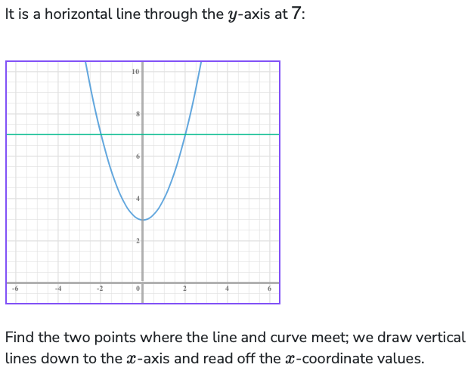
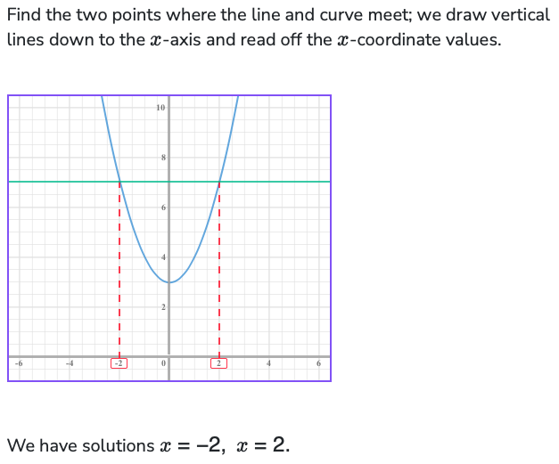
Solving quadratic equations graphically

Slide 18
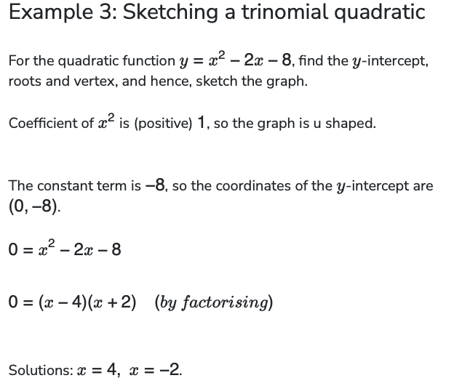
Sketching quadratic graphs

Slide 19
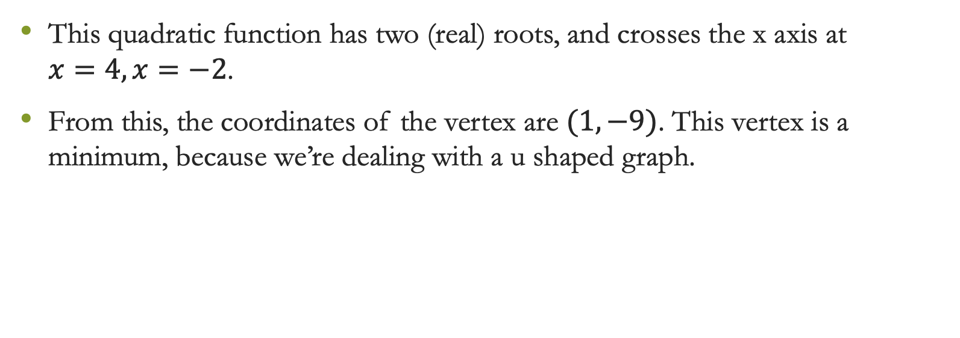
Sketching quadratic graphs
This quadratic function has two (real) roots, and crosses the x axis at
$x=4,x=−2$.
From this, the coordinates of the vertex are $(1,−9)$. This vertex is a minimum, because we’re dealing with a u shaped graph.

Slide 20
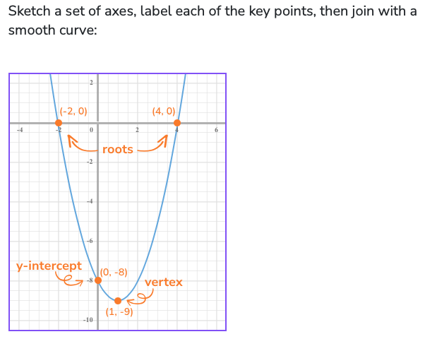
Sketching quadratic graphs

Slide 21

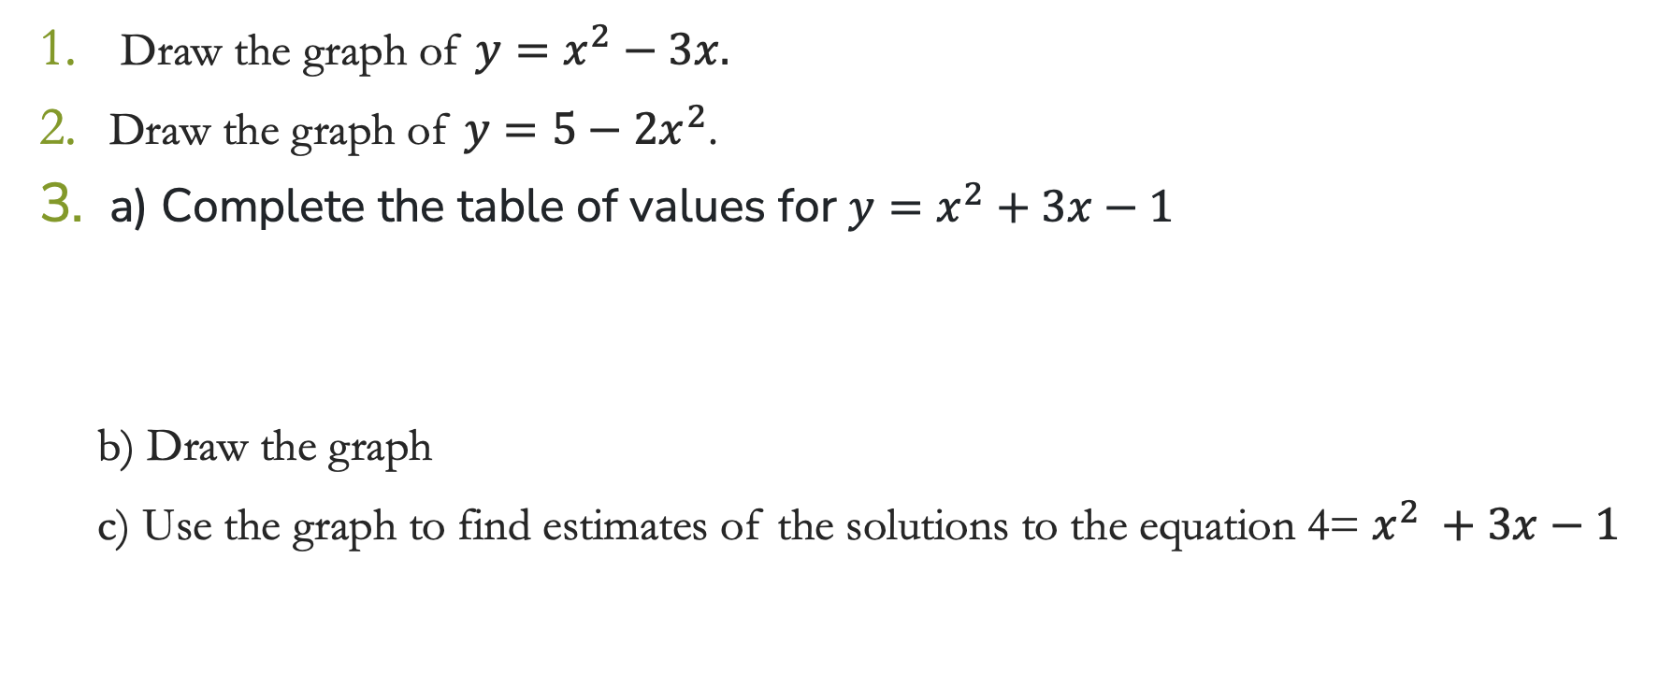
Practice Examples
Draw the graph of $y=x^{2}−3x.$
Draw the graph of $y={5−2x}^{2}$.
a) Complete the table of values for $y=x^{2}+3x−1$
b) Draw the graph
c) Use the graph to find estimates of the solutions to the equation 4= $x^{2} +3x−1$

Slide 22
Thank You

